Slide 1



Statistical Learning for Unimpaired Flow Prediction in Ungauged Basins
Research supported by the NSF GRFP under Grant No.1650042 and the Climate Change, Water, and Society NSF IGERT, to UC Davis DGE No.1069333.
Any opinion, findings, and conclusions or recommendations expressed in this material are those of the author(s) and do not necessarily reflect the views of the National Science Foundation.
Ellie White, Ph.D.
Department of Civil & Environmental Engineering
University of California, Davis
November 18th, 2020
Mayer, B. Newsweek (2015)
Notes:
Bill Mayer, Newsweek, “The Future of Farming: The Nuts and Bolts of How We Will Feed the World.”
Remember to SLOW DOWN

Slide 2
Presentation Outline
Data
Statistics knowledge map
Some statistical learning methods
Linear Regression Models (LM)
Generalized Linear Regression Models (GLM)
Random Forests (RF)
Neural Networks (NN)
Data Transformations
Loss functions for optimization
Resampling for test set error approximation
Let’s break it-with climate change
Model Selection
Model Selection
Loss Function
Optimization & Tuning/Testing
Results & Benchmarking
etc.

Slide 3
Definition of Terms
Machine Learning (ML) → Algorithms, Implementation
Statistical Learning → Theory, Mathematics
Artificial Intelligence (AI) → Human Intelligence
Loss function → Objective function to minimize
Auto-correlation → Dependence and correlation within the data set (e.g., temporal, spatial, hierarchical)
Predicting Ungauged Basins (PUB)
Response Variable → Y: Unimpaired Flows
Predictor Variables → Xs: Precipitation, Drainage Area, Soil Type….
Notes:
International Association of Hydrological Sciences (IAHS) grand challenge 2003-2012 decade.

Slide 4
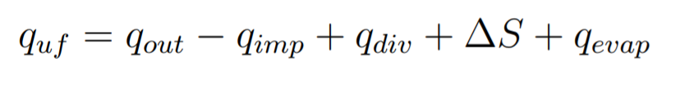
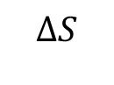
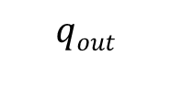
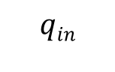
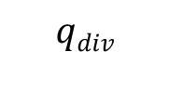
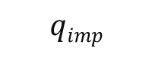
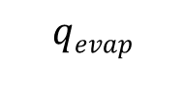
Problem Statement
$$qevap$$
$$qin$$
Predicting Ungauged Basins (PUB)
Extrapolating information in space
$$ΔS$$
River
Gauge
Basin 1
Basin 2
Basin 3
Basin 4
?
1
$$qdiv$$
2
$$qimp$$
?
4
?
Reservoir
$$qout$$
Gauge
3
Notes:
Unimpaired flow is the flow produced by the basin in its current state, but without human created or operated water storage, diversion, or return flows
Assumptions of PUB: 1) The past is a reasonable guide to the future, 2) Data from one basin is a useful guide to understanding hydrological responses at another basin.
(Sivapalan, 2003)

Slide 5
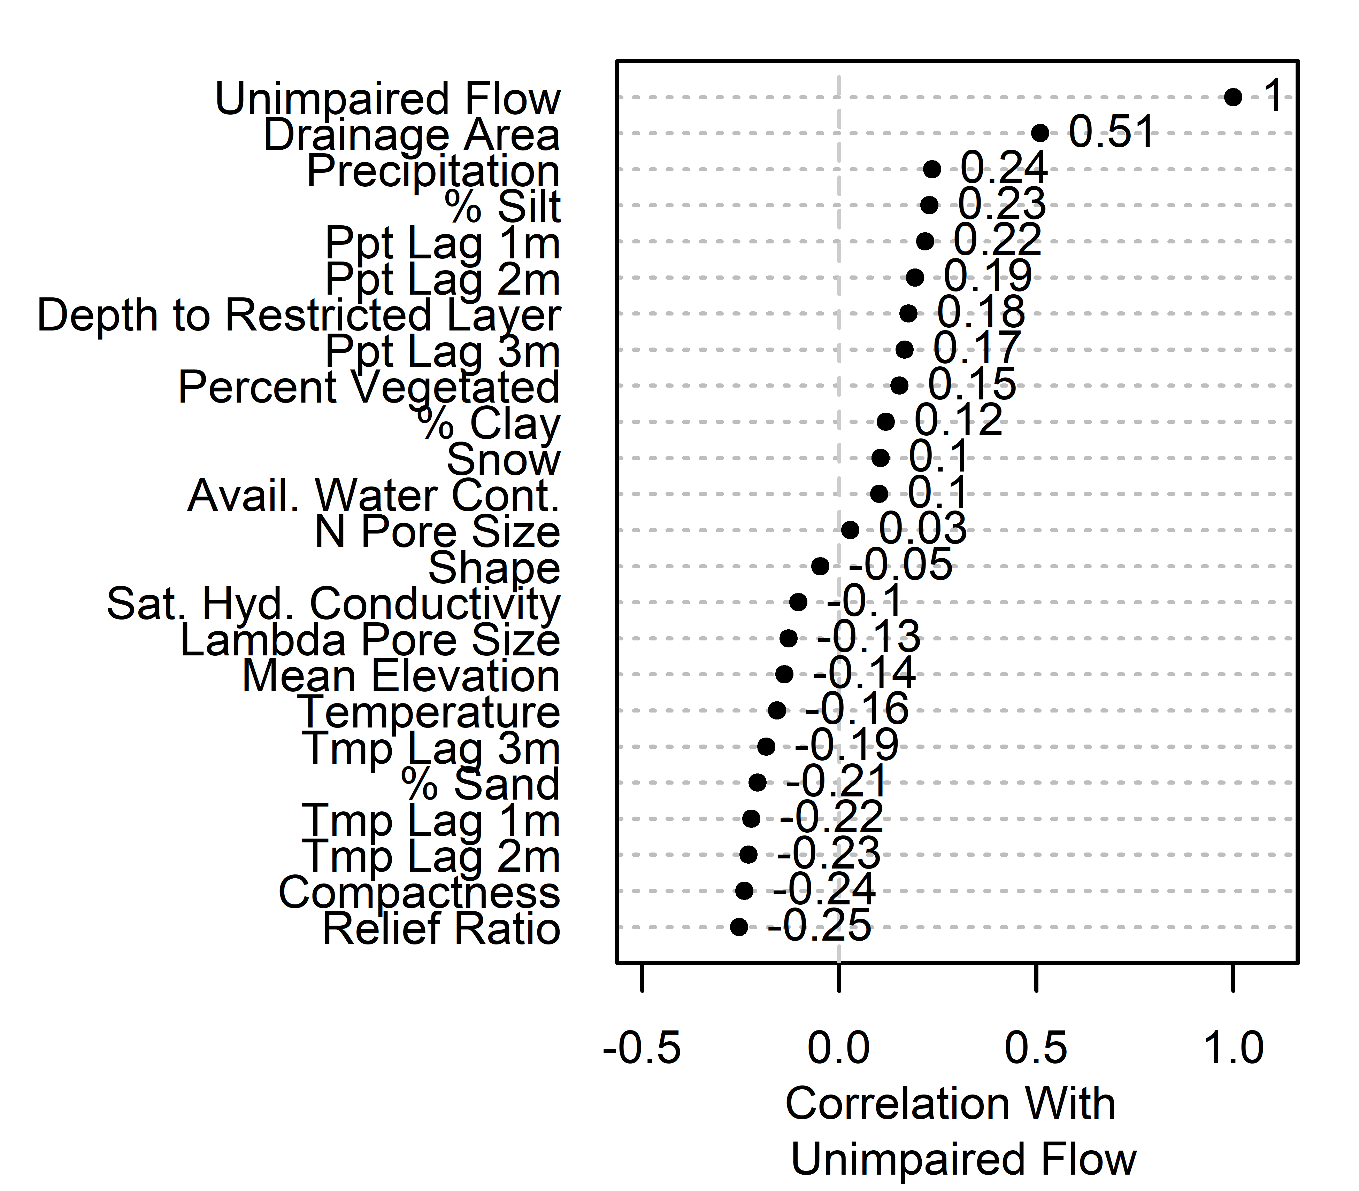
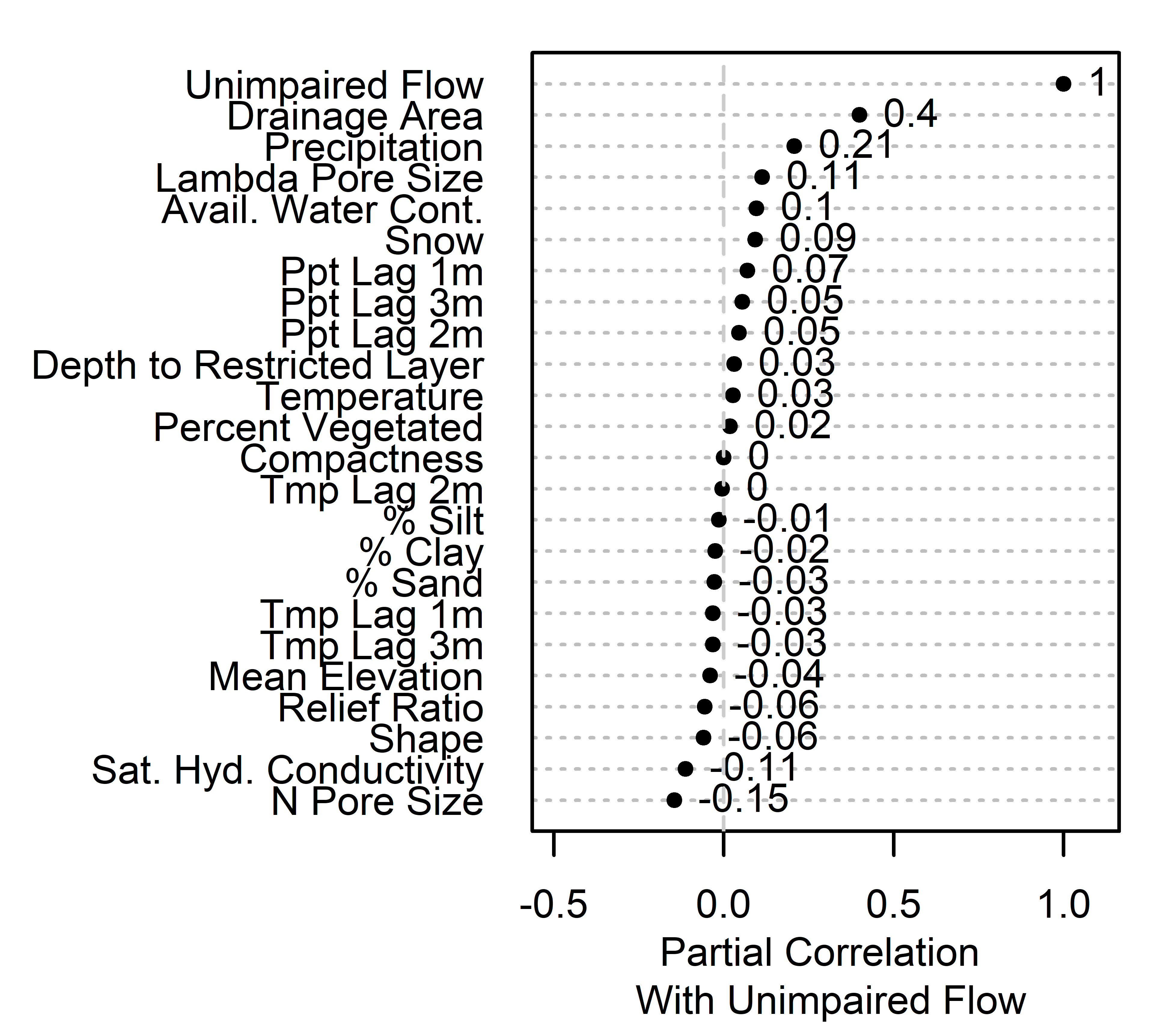
Data

Slide 6
Statistics Knowledge Map
Notes:
The purpose of this map is to provide a guide for model selection. To quote Aristotle: “If two things are similar, the thought of one will tend to trigger the thought of the other.” So, the idea is to put concepts together.

Slide 7
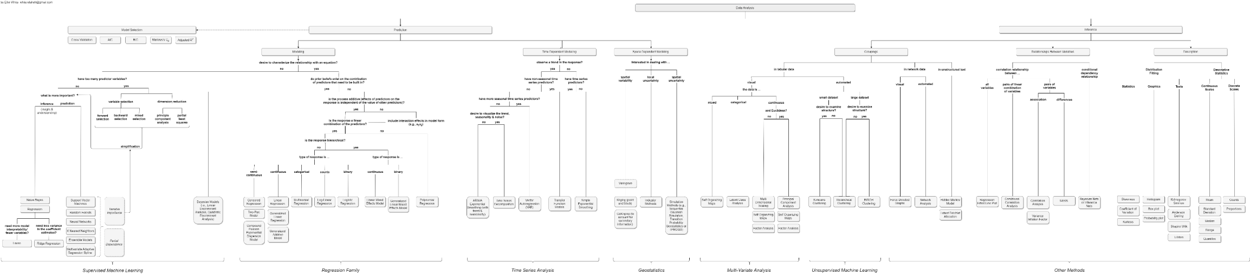
Statistics Knowledge Map
Statistics Knowledge Map
Statistical Learning Methods
LM
GLM
RF
NN
Data Transformations
Loss Functions
Resampling
Climate Change
Notes:
https://github.com/whiteellie/phd-predicting-unguaged-basins/blob/master/ch1%20stats%20flowchart/drawio/statsflowchart_fordiss.png
My motivation was to organize my head, or as Jay puts it “organizing the chaos.” It’s a systematic description of the techniques and gives us an understanding of techniques by studying the relationships among them. Imparts one particular view of the world.

Slide 8
Knowledge Map Categories
Statistics Knowledge Map
Statistical Learning Methods
LM
GLM
RF
NN
Data Transformations
Loss Functions
Resampling
Climate Change
Supervised machine learning → prediction in the past
Regression family → inference
Time series analysis → extrapolation into the future
Multi-variate analysis → natural groupings
Unsupervised machine learning → natural groupings
Other methods → patterns and relationships between variables
Notes:
I grouped the statistical methods into six main categories:
Supervised machine learning methods are more generally used for prediction modeling where no equation is needed to represent the model and you don’t want to emphasize the fact that the data is organized in time/space.
On the other hand, the regression family of methods are used when the purpose is more inference than prediction, and equations, or more specifically the coefficients of the variables in the equations, is of interest.
Time series analysis is most suited to the prediction problems that need to extrapolate into the future. And in geostatistics you are interpolating in space.
Under pattern recognition problems sets, multi-variate analysis and unsupervised machine learning methods and natural groupings in the data.
Other methods handle networks, text, patterns caused by latent factors, and relationships between variables, which generally don't apply to problems in water resources.

Slide 9
Statistical Learning Methods

Slide 10
Hydrologic Model Classification
Statistics Knowledge Map
Statistical Learning Methods
LM
GLM
RF
NN
Data Transformations
Loss Functions
Resampling
Climate Change
We are here!
Total a priori ignorance
Total a priori knowledge
Statistical
Lumped
Integral
Distributed
Integral
Distributed
Differential
Purely stochastic
Causal
Notes:
Traditionally most hydrology consisted of mechanistic models. Mechanistic models define the underlying physics equations of flow. But statistical learning techniques provide us with a simpler alternative.

Slide 11
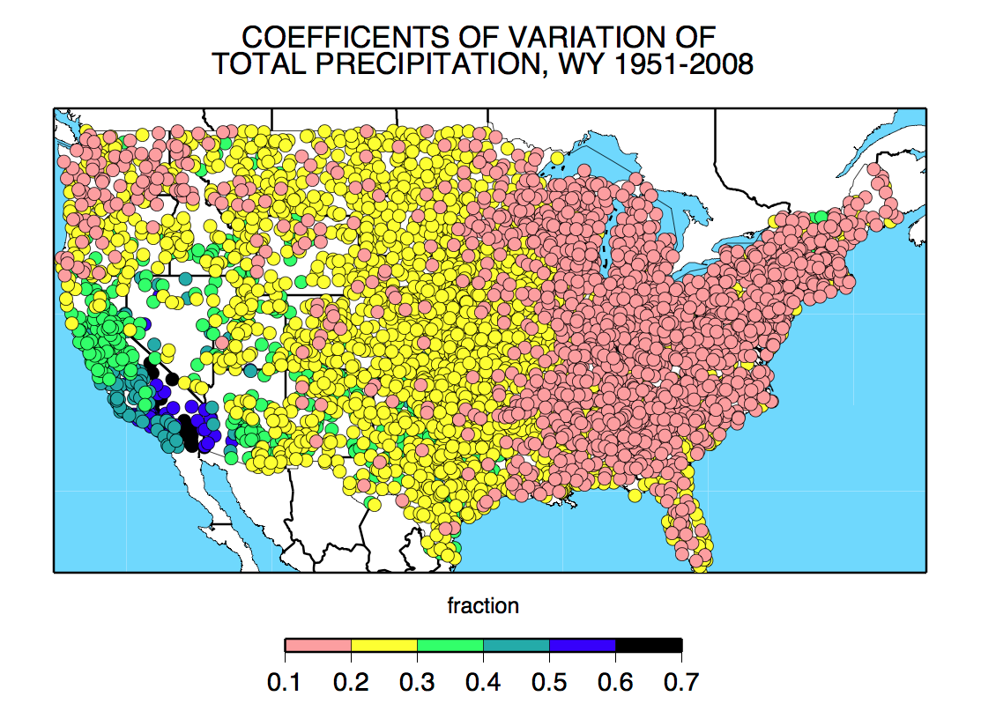
Weaknesses of Empirical Models
Statistics Knowledge Map
Statistical Learning Methods
LM
GLM
RF
NN
Data Transformations
Loss Functions
Resampling
Climate Change
Overfitting → training and testing set
Interpolation formulas → (Dettinger, 2011)
Non-stationarity → short training & decomposition methods
Complexity in model structure → dimensionality reduction & regularization methods
Arbitrariness in the selection of the form → apply more methods
Nature of the algorithms (e.g., averaging) → averaging, peculiar behavior that isn’t understood
Dettinger et al. (2011)
Notes:
In addition to concerns with spatial extrapolation, there is temporal extrapolation. As we now face climate change imposing non-stationarity on environmental variables like precipitation and temperature, empirical models for ow should not be used to extrapolate beyond the limits of the variables the model observes or it will run the risk of large errors. However with short training and testing records (or in long records where trend seasonality and noise can be decomposed) this phenomenon does not introduce a substantial problem.
Another downside is the complexity in model structure, especially in ensemble statistical learning methods, which are sometimes referred to as black-box models. If inference, or model parameters, are of interest complex models will introduce challenges. Dimensionality reduction methods (e.g., principle component analysis, partial least squares) and regularization techniques
in regression (e.g., ridge, lasso, and elastic net) can help reduce the number of parameters in the model, and therefore, systematically produce a simpler model structure.
The essential arbitrariness in the selection of the form of an empirical model is another drawback (Klemes, 1982). Most studies report using one modeling method, which perhaps suggests that researchers are not employing more than one modeling method. Such a study could provide insights into the system by revealing the sensitivity of results to the algorithms employed. Therefore,
the application and comparison of different machine learning models to the ungauged basin problem was considered in this study.
Lastly, there are limitations caused by the nature of the algorithms deployed. For example, regression-based random forest models make predictions by averaging predictions made by multiple regression trees. Therefore, the ensemble model limits the predictions it makes to the range seen in the training data; in other words, the predictions do not extrapolate to ranges not seen in the training data. In fact, the averaging dampens the density function when we compare the observed to the predicted data. This is especially problematic where the extreme tails of the distribution (i.e., the floods and droughts) are of interest.

Slide 12
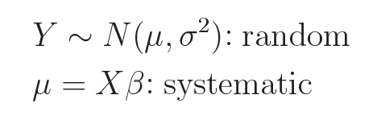
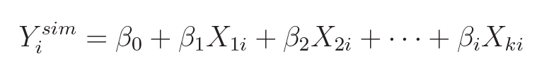
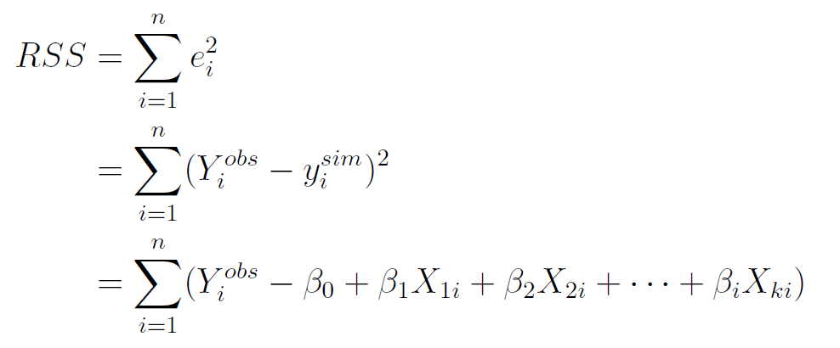
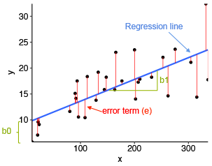
Linear Regression Model (LM)
Statistics Knowledge Map
Statistical Learning Methods
LM
GLM
RF
NN
Data Transformations
Loss Functions
Resampling
Climate Change
Model parameters found through minimizing losses (optimization)
Notes:
They are easy to understand and interpret, which makes them a great first cut at predictive modeling. However, they oversimplify reality
(hydrologic processes are not linear) and lack precision or predictive ability (as demonstrated by poor goodness-of-t measures). Another major aw is that a linear predictor can give predictions that are physically impossible (e.g., negative flows). In PUB modeling, the variance cannot be considered constant since there is a boundary on the response. These shortcomings can be overcome with generalized linear models.

Slide 13
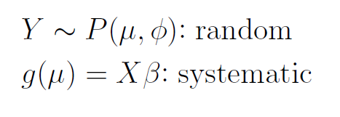
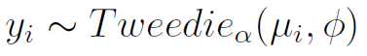
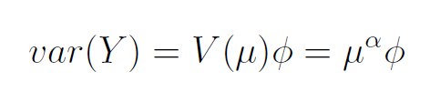
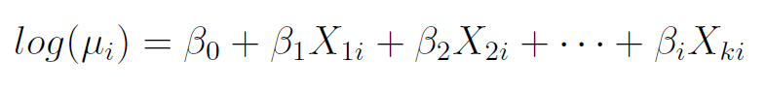
Generalized Linear Regression Models (GLM)
Statistics Knowledge Map
Statistical Learning Methods
LM
GLM
RF
NN
Data Transformations
Loss Functions
Resampling
Climate Change
Basically an LM
Where the random component is a known distribution
Model parameters found through maximum likelihood
Notes:
Unlike LMs, GLMs can accommodate non-Normal distributions of error. So, P is the distribution of random errors and g(mu) is the link function. P and g can be set by the user.
Tweedie distributions are great for PUB, since the outcome (or unimpaired flow) is continuous, nonnegative, skewed, and unbalanced with exact zeros. Tweedie distributions are a special case of exponential dispersion models where the variance function is a power function. Special cases include Normal (=0), Poisson (=1), Gamma (=2), and inverse-Gaussian (=3) GLMs . Here, we set the power to be 1.1-found through cross-validation. The dispersion
parameter, phi, was estimated using the RSS (or the Pearson estimator).
The link g can be specified as log or identity. The link is the function used to explain how the expectation of the outcome is related to the linear predictor, and the log-link was used for this problem.
Both LMs and GLMs are parametric models. For prediction purposes, non-parametric methods have potential to out-perform parametric methods, since their form is shaped by the data and not fixed a priori (James et al., 2013). Therefore, next, we consider a nonparametric modeling method, random forests.

Slide 14
Random Forests (RF)
Statistics Knowledge Map
Statistical Learning Methods
LM
GLM
RF
NN
Data Transformations
Loss Functions
Resampling
Climate Change
A collection of decision trees
Randomness comes from:
1) bootstrap samples
2) sampled predictors
Notes:
Trees stratify or segment the predictor space, into a several regions, using a series of if-then statements. At each internal node in
the tree, a test is made to one of the inputs. Depending on the outcome of the test (or split rule), the algorithm goes to either the left or the right sub-branch of the tree. Eventually the algorithm arrives at a terminal branch, which is the prediction. The prediction for a given observation is the mean or the mode of the training observations in the region to which it belongs.
The split rule is found using a greedy top-down search for recursively splitting of the data into binary partitions. It is greedy, because the split rule at each internal node is selected to maximize the homogeneity of its child nodes, without consideration of nodes further down the tree, yielding only locally
optimal trees.
CARTs suer from high variance; trees grown on different subsets of the training set will produce different predictions. RFs attempt to improve the prediction accuracy of trees with the idea that combining and averaging trees reduces variance. To produce different looking trees we need some randomness, which comes from either 1) sampling the data or 2) sampling the predictors at each node.
But it’s counter-intuitive to withhold data from a model. Right? And with sampling we are doing just that. Especially when sampling the predictor variables. This allows for the model to grow trees that are uncorrelated. Why? Because let’s say you have a strong predictor variable, if you allow the trees to make a split based on whatever variables it wants, they will all chose that strong predictor, and therefore the trees in the forest end up looking somewhat alike. But limiting it will produce uncorrelated trees and a stronger forest.

Slide 15
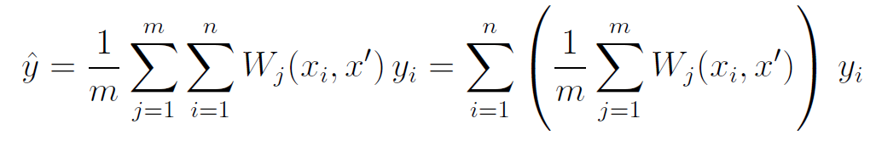
Random Forests (RF)
Statistics Knowledge Map
Statistical Learning Methods
LM
GLM
RF
NN
Data Transformations
Loss Functions
Resampling
Climate Change
prediction

Slide 16

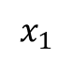
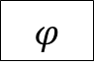
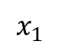
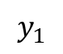
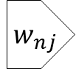
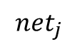
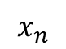
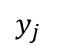
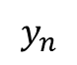
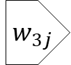
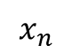
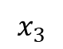
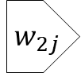
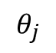
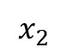
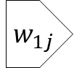
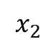
Neural Networks (NN)
Statistics Knowledge Map
Statistical Learning Methods
LM
GLM
RF
NN
Data Transformations
Loss Functions
Resampling
Climate Change
input
layer
hidden
layer
output
layer
propagation
function
activation
function
inputs
weights
outputs
$$x_{1}$$
$${ w}_{1j}$$
$$\sum{w_{i}x_{i}}$$
$${net}_{j}$$
$$x_{1}$$
$$x_{2}$$
$${ w}_{2j}$$
$$φ$$
$$y_{j}$$
$$y_{1}$$
activation
$$x_{2}$$
$$x_{3}$$
$${ w}_{3j}$$
neuron
$$θ_{j}$$
.
.
.
threshold
.
.
.
.
.
.
.
.
.
$$y_{n}$$
$$x_{n}$$
$${ w}_{nj}$$
$$x_{n}$$
Notes:
Based on the concept of neurons firing. The components of a neural network: the layers, nodes, activation function, and output layer transformations. Deep learning refers to neural networks with a higher number of hidden layers than the typical two layer fully connected network that is depicted.
At each node, the weighted sum of all inputs are passed through a non-linear activation function. Much like the neurons in our brains, there is a threshold that determines if the neuron will fire.
Now to set up the optimization to find the weights. The error depends on the weighted sum and the weighted sum depends on the weights. So the derivative of the error function uses the chain-rule! Called backpropagation. And with that you know how much to adjust your weights to get a lower error. Rmsprop is usually used for optimization, which is the gradient descent algorithm with momentum. Momentum restricts the oscillation in one direction. So that by increasing the learning rate, the algorithm takes larger steps in one direction to converge faster.
NNs are the most popular. And my theory is that it’s because NNs have a thresholding behavior (a neuron has to have inputs over a certain level to fire). Hydrology works the same way. 1) Thresholding in the fill-and-spill hypothesis by Hewlett, 1961: Precipitation feeding into a stream must satisfy soil moisture deficits along its flow path before it produces runoff. In other words, the soil needs to fill to a threshold before it can spill to become runoff (Spence & Woo, 2006). 2) Precipitation Thresholds to generate runoff: the theory is that there is a memory of connectivity in flow systems (Moore, 1997)

Slide 17
Data Transformations

Slide 18
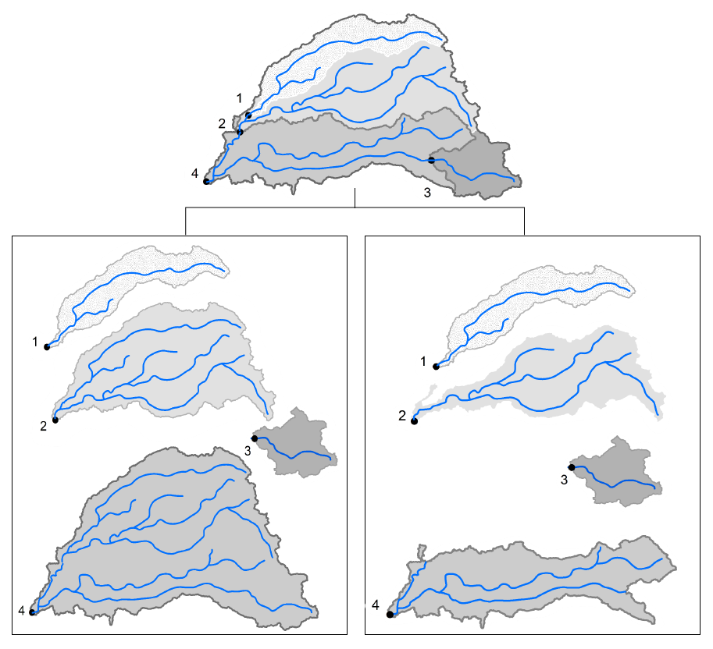
What is an Observational Unit?
Statistics Knowledge Map
Statistical Learning Methods
LM
GLM
RF
NN
Data Transformations
Loss Functions
Resampling
Climate Change
Aggregate
Incremental

Slide 19
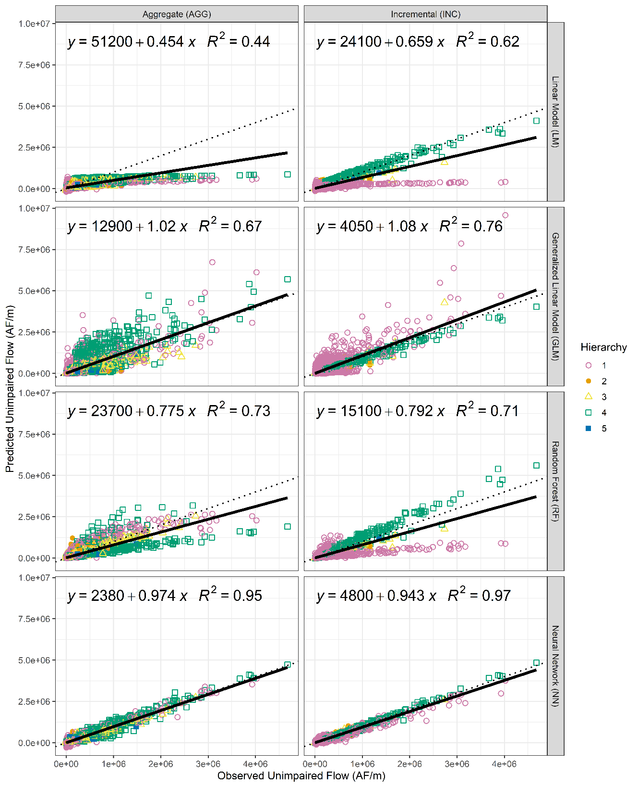
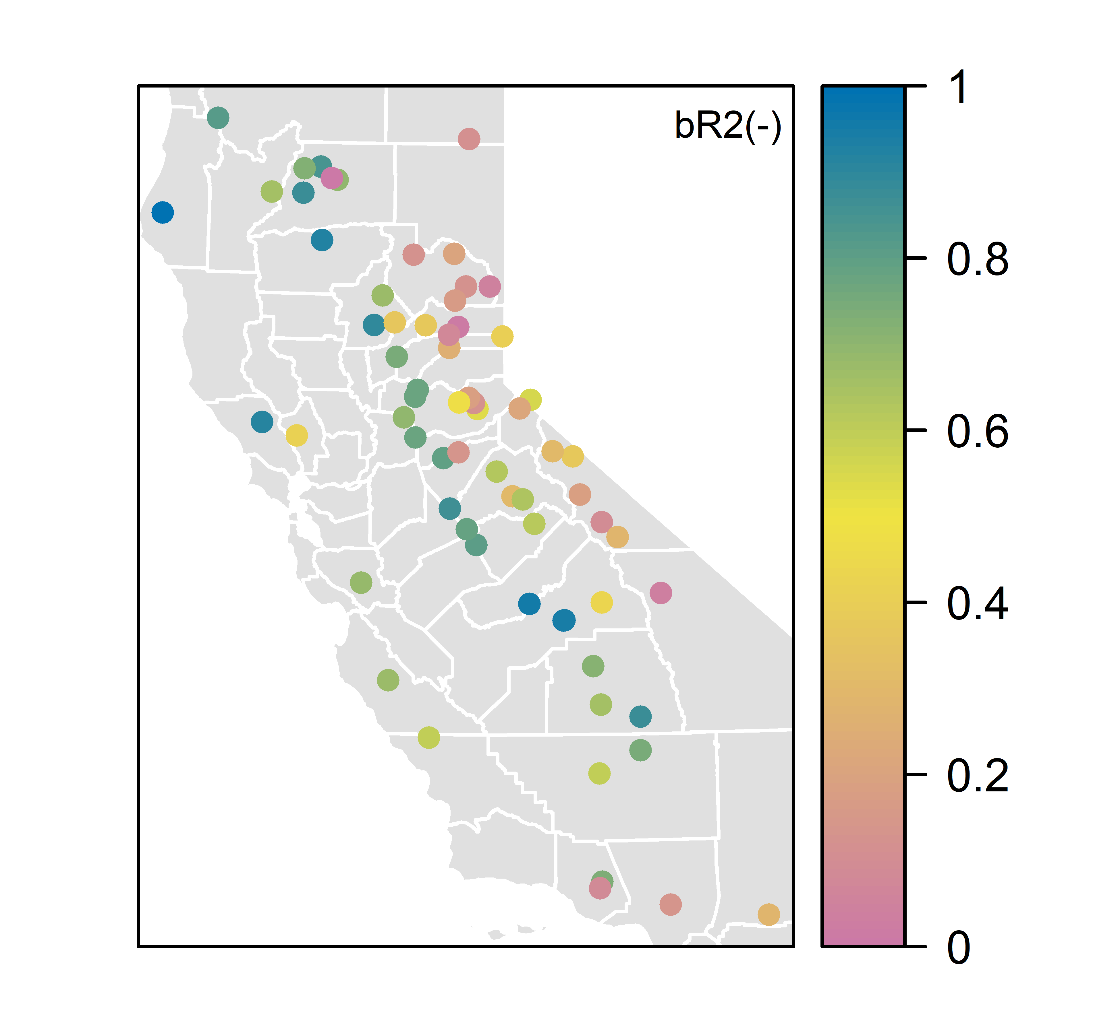
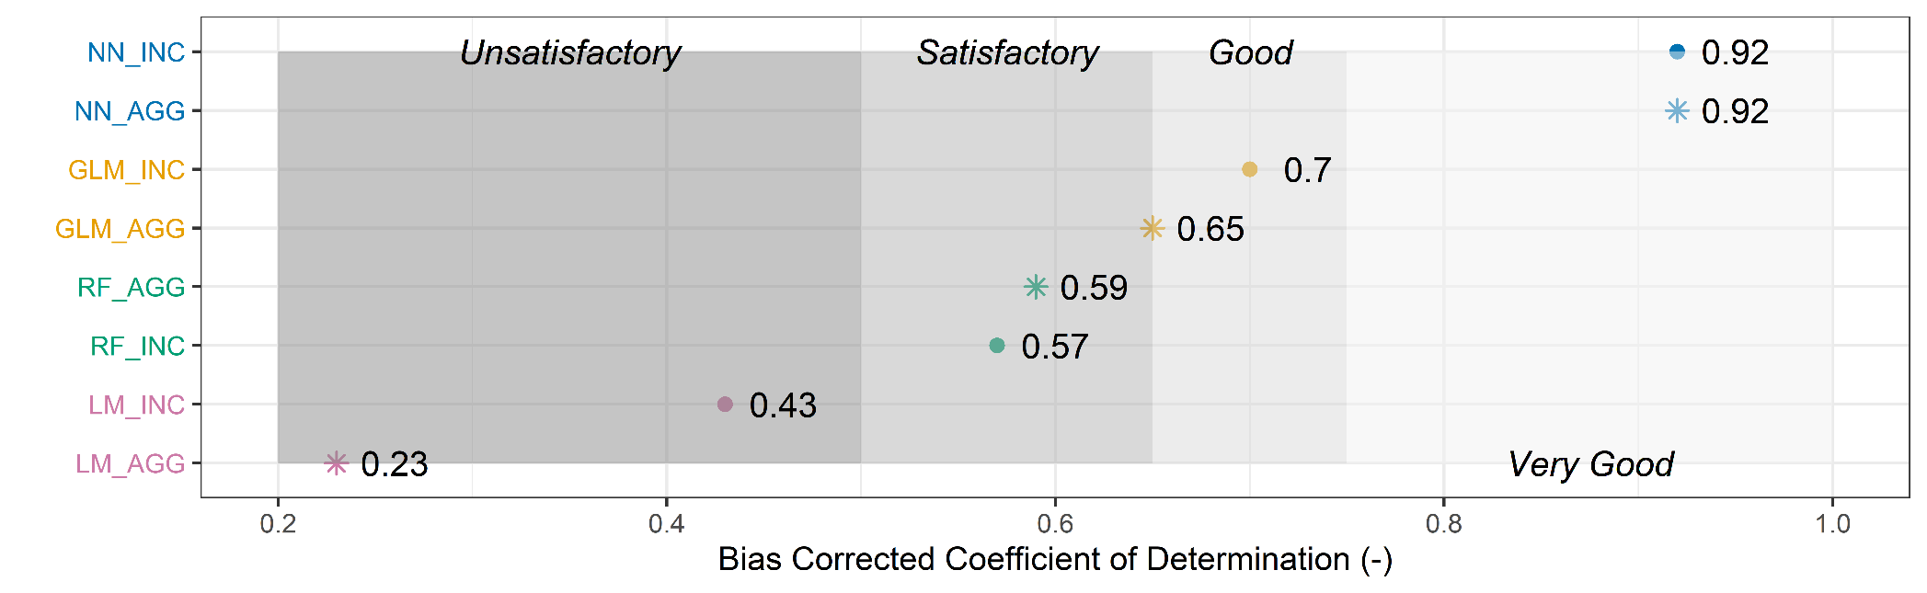
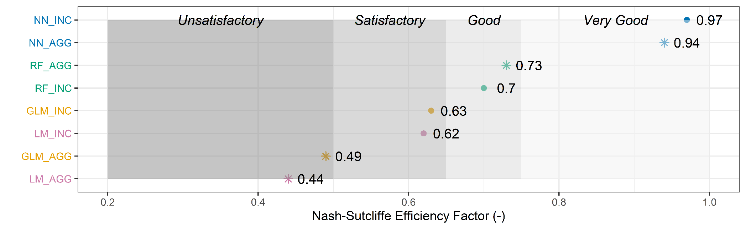
Results
Statistics Knowledge Map
Statistical Learning Methods
LM
GLM
RF
NN
Data Transformations
Loss Functions
Resampling
Climate Change
Notes:
NN AGG spatial results

Slide 20
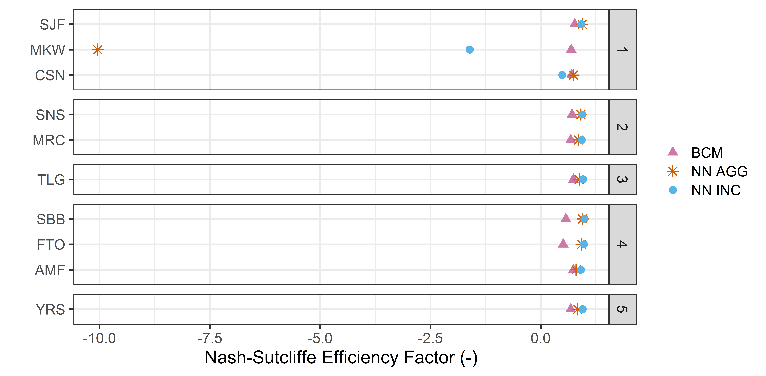
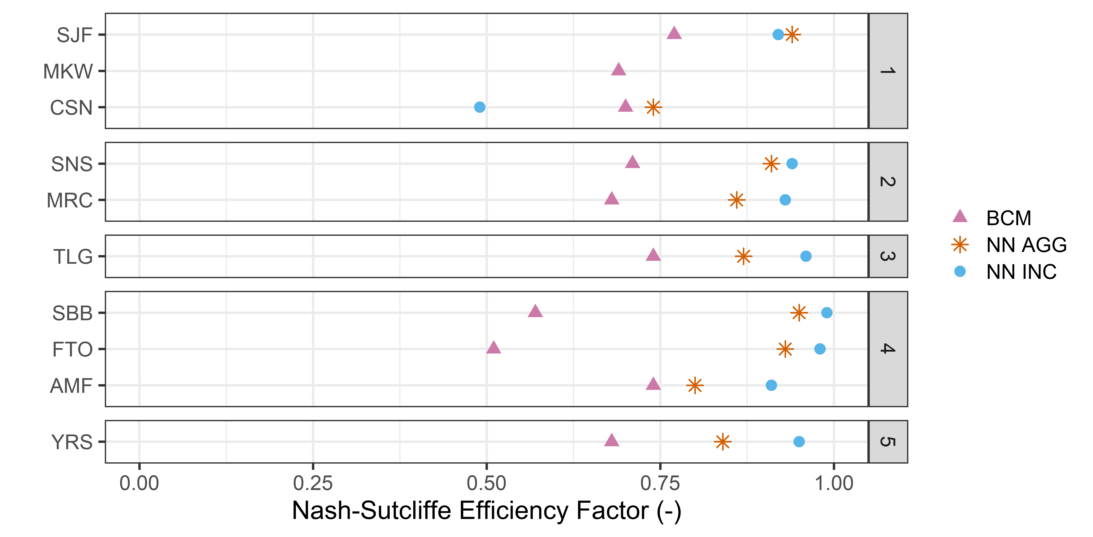
Benchmarking
Statistics Knowledge Map
Statistical Learning Methods
LM
GLM
RF
NN
Data Transformations
Loss Functions
Resampling
Climate Change
Notes:
The models in this study are especially weak in predicting MKW unimpaired flows, possibly, due to its very short length of record (only two years or 24 observations) compared to other basins (typically 32 years or 393 observations). The NN in both aggregate and incremental methods out-perform the BCM in eight of ten basins.

Slide 21
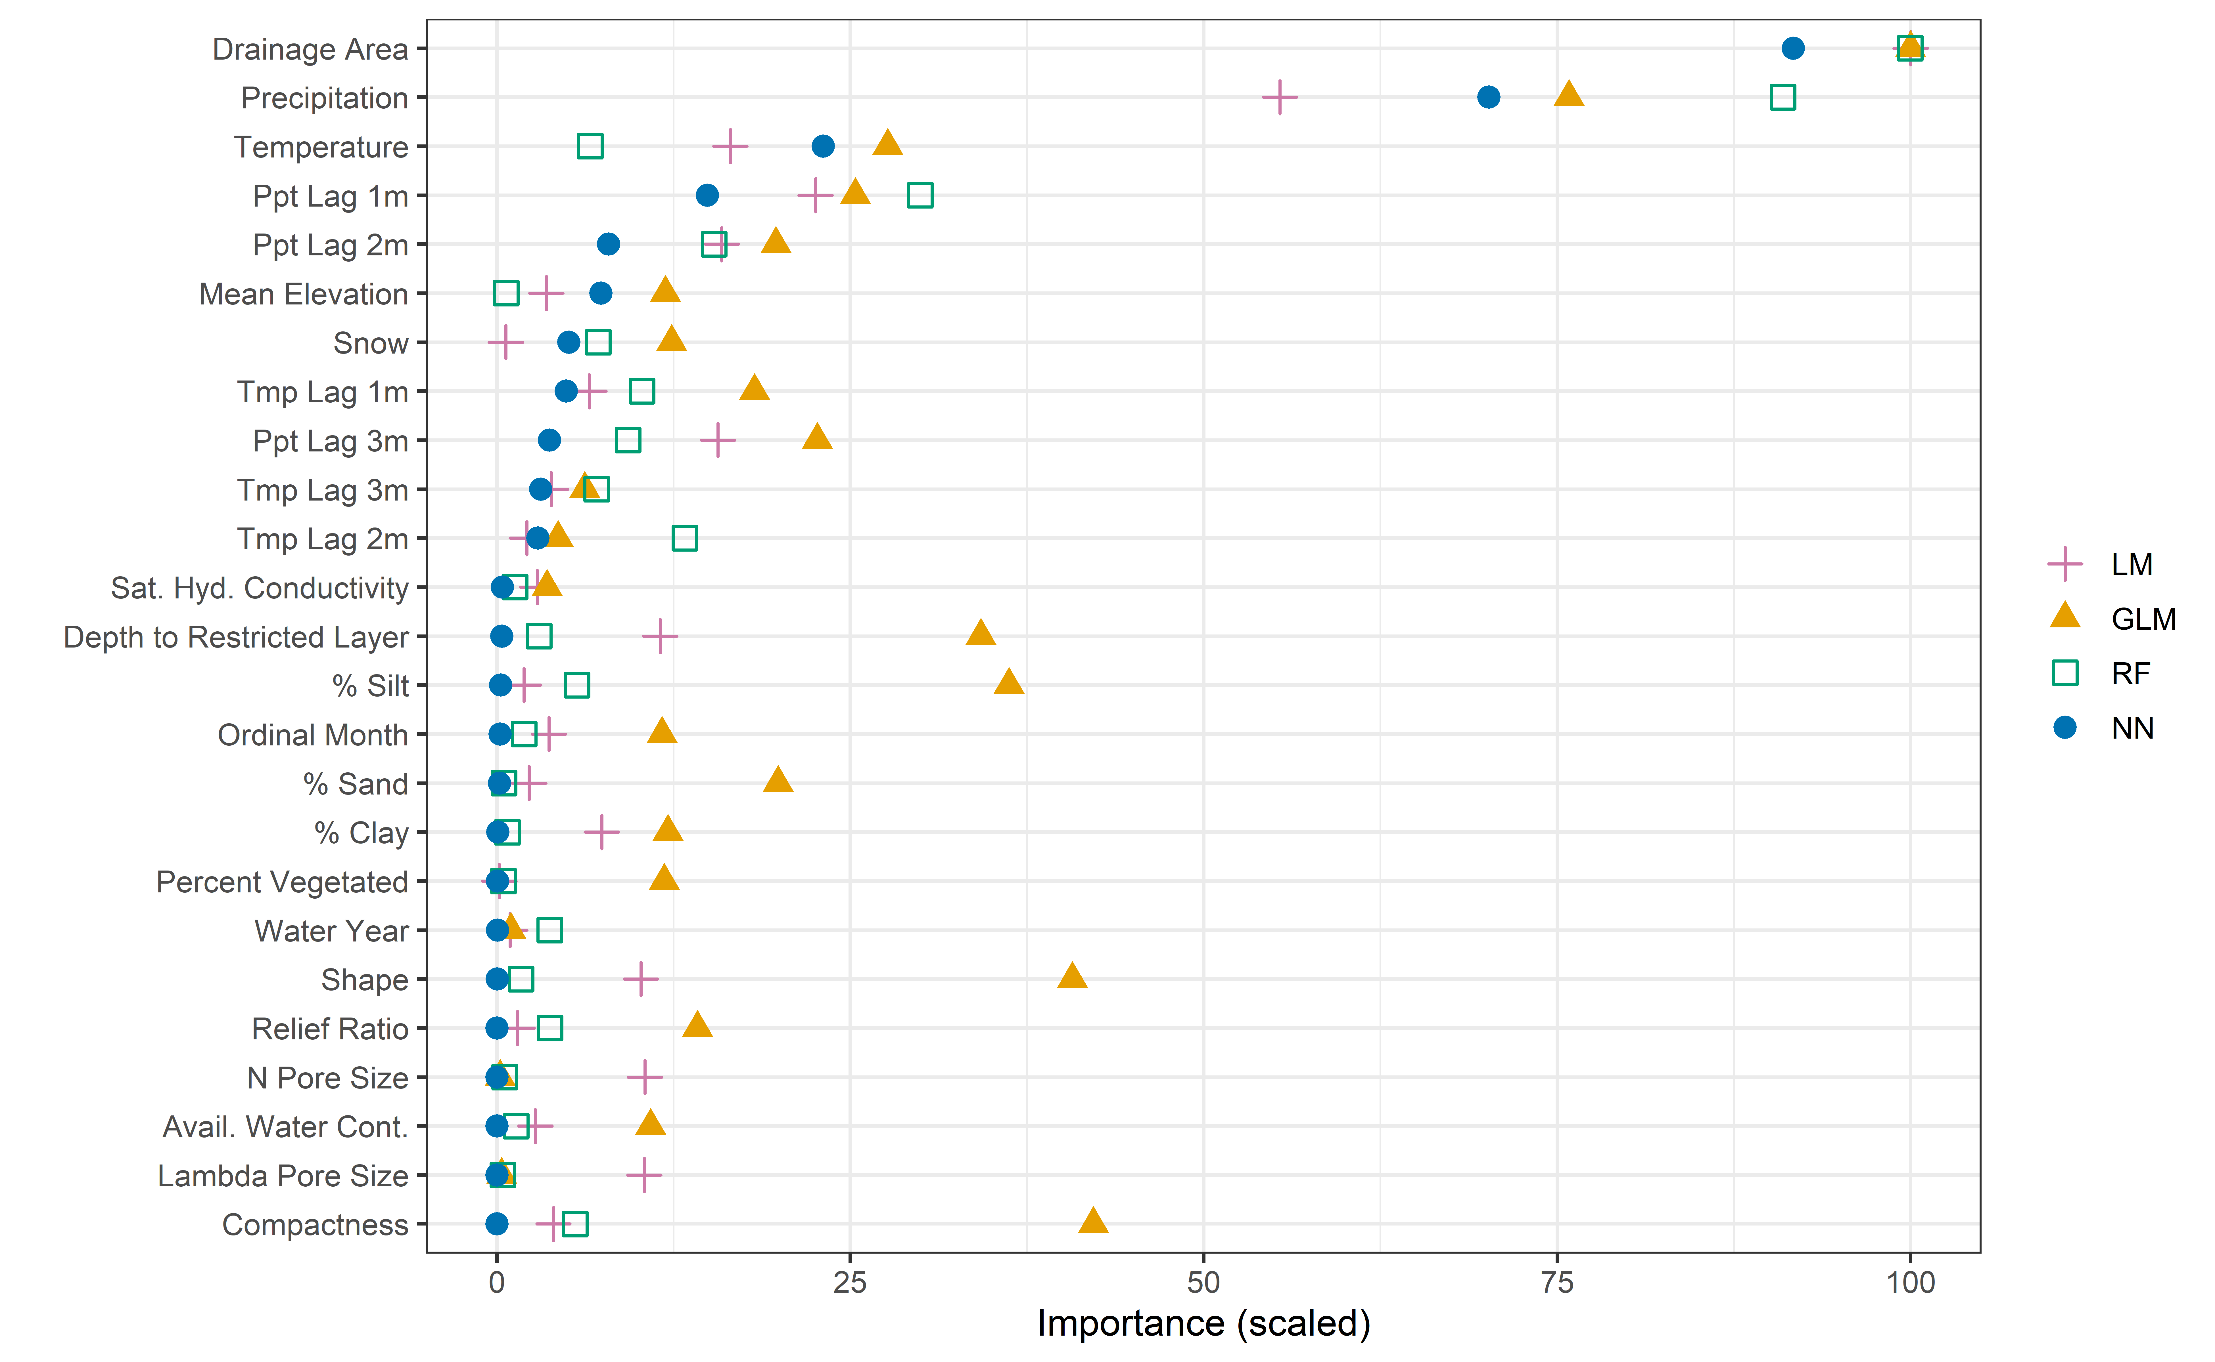
Variable Importance Plot
Statistics Knowledge Map
Statistical Learning Methods
LM
GLM
RF
NN
Data Transformations
Loss Functions
Resampling
Climate Change
Notes:
A basin's drainage area and precipitation are the most important variables in predicting monthly unimpaired ow regardless of model type. Next are lagged precipitation and temperature variables, the snow variable manually calculated from precipitation and temperature, and the mean elevation of the basin. Other variables do not have significant effects on the model performance especially in the NNs. As the addition of variables brings new information to models like the GLM, and improves their performance, the NN prefers extra layers in its network. The trend in the development of NNs has been to develop deeper networks, rather than wider ones, to improve model performance. The advantage of multiple layers is that they can learn features at various levels of abstraction (Antognini, 2016). The flexibility in the depth of a NN means NNs can learn information from fewer variables.

Slide 22

Takeaway
Incremental basin modeling provides an easy way to include network information in statistical models.
The NN can learn a whole lot from a few parameters.

Slide 23
Break – 5min

Slide 24
New Loss Functions

Slide 25
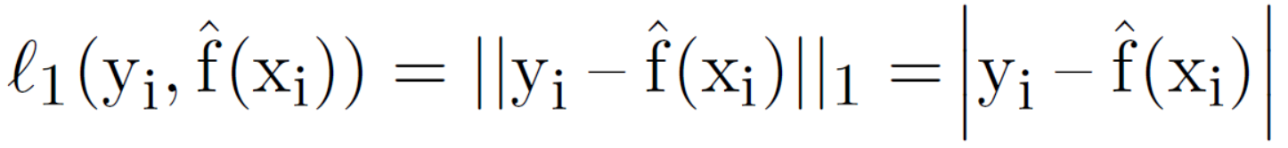
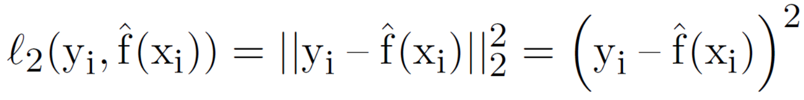
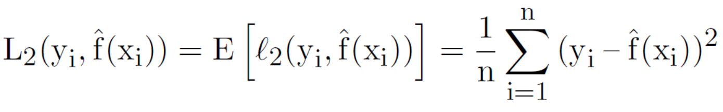
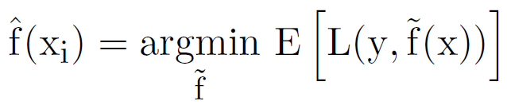
Definition of Terms
Statistics Knowledge Map
Statistical Learning Methods
LM
GLM
RF
NN
Data Transformations
Loss Functions
Resampling
Climate Change
Loss → distance between observed and predicted
Risk → expectation of the losses
Expectation=aggregate (or average) over all the points
Commonly called loss too
Regret → difference between the consequences of a suboptimal decision and the optimal decision
Risk minimization framework
Notes:
Typical loss functions in statistical learning are the l1 norm and l2 norm.
Loss is defined on one observation.
Risk, or cost, is defined as the expectation of the loss function.
Regret is the difference between the consequences of a sub optimal decision and the optimal decision. Some argue that, in machine learning, the objective should be to always minimize regret. However, to avoid developing a mathematical representation for regret, we will leave this discussion and proceed with the much simpler risk-minimization framework.
So we define the machine learned model to be the one that has a minimum expected loss out of all the possible models.

Slide 26
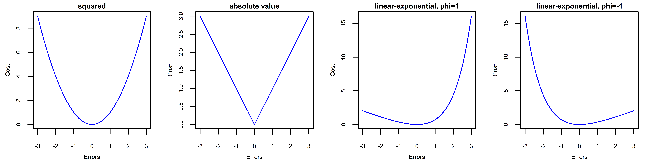
Typical Loss Functions in Statistical Learning
Statistics Knowledge Map
Statistical Learning Methods
LM
GLM
RF
NN
Data Transformations
Loss Functions
Resampling
Climate Change
L₂
L₁
LINEX
Notes:
The cost of being over prepared for a flood is not as much as being underprepared for it.

Slide 27




Designing a Loss Function for PUB
Statistics Knowledge Map
Statistical Learning Methods
LM
GLM
RF
NN
Data Transformations
Loss Functions
Resampling
Climate Change
Symmetric vs. Asymmetric → Asymmetric
Notes:
develop a loss function that produces more conservative predictions at the peaks. For example, over predicting the severity of a flood, or a drought, is better than under predicting it. This approach would require us to label all points as either a peak, normal, or drought point. The difficulty lies in developing a labeling mechanism (i.e., a classification model) before running the regression model on predicted peak, normal, or drought labels. It is possible though, that if the entire data set is put through this method, we will be introducing “data leakage" or the leakage of information on the response variable into the model; the classification model will be trained on the response variable which is supposed to be modeled and unknown.
Alternatively, we can fit a thin plate spline to the data with a predefined degree of smoothness (i.e., degree of freedom), then find the points at which the direction of curvature (the second derivative) in the time series changes, and lastly dene two asymmetric loss functions for each of the peak and valley sections (See Figure 4.1). Such loss functions can be defined as linear exponential (LINEX) loss if smoothness is desired.
However, current subgradient-based and derivative-free methods of optimization in convex programming can easily handle the non-differentiability at the origin of the loss function. In fact, many asymmetric loss functions in machine learning have a simple kink in them, which makes them otherwise entirely differentiable.

Slide 28


Designing a Loss Function for PUB
Statistics Knowledge Map
Statistical Learning Methods
LM
GLM
RF
NN
Data Transformations
Loss Functions
Resampling
Climate Change
Symmetric vs. Asymmetric → Asymmetric
Absolute vs. Relative → Absolute (Criss & Winston, 2008)
Continuous vs. Stepwise → Continuous
Homogeneous vs. Heterogeneous → Homogeneous
➔
1)
2)
j = 3
3)
Notes:
Should we be concerned with relative errors or straight errors? In hydrology, both manual and automatic attempts aimed at minimizing straight errors often lead to fitting the higher portions of the hydrograph (i.e., peak flows) at the expense of the lower portions (i.e., baseflow) (Krause, Boyle, & Base, 2005). But it is clear that relative errors are generally more important
than straight errors. For example, a 10 TAF error in 1,800 TAF (monthly annual average of the Sacramento River) is less extreme of an error than in 15 TAF (monthly annual average of the Colorado River). Relative error loss functions or a simple log transformation of the data can help in this regard.
Should losses be on a continuous function, or multiple ones for each region? Although, most outcomes may follow a discontinuous step function (e.g., a neuron ring or not), continuity and differentiability will help make the math more convenient. In fact, one of the major development in neural networks was the doing away with the concept of thresholds in the step
function (representing the collective influence of all the inputs) and replacing it with a smoother sigmoid function. As was the case with neural networks, some optimization algorithms require continuity and differentiability (e.g., gradient decent). However, advances in these methods now allow for many different shapes in the loss function.
Should losses be weighted based on geographic region? The cost of incorrectly managing a densely populated urban basin may be very different than a desert or a headwater basin; the importance of having accurate ow estimates is not completely homogeneous especially across a big and diverse region as California. However, to avoid making those judgements, we will use a single loss function across all regions.

Slide 29

Results
Statistics Knowledge Map
Statistical Learning Methods
LM
GLM
RF
NN
Data Transformations
Loss Functions
Resampling
Climate Change
Notes:
American River at North Fork Dam, USGS gauge

Slide 30
Takeaway
Asymmetric loss functions help:
To represent the desire to be conservative
To fix the problem of fitting the peaks at the expense of lower flows
Notes:
Use symmetric functions when you care to predict the mean correctly not the tails. The LOGCOSH performs similarly to the MAE and MSE. The LOGCOSH and MAE are useful when errors in the estimates for larger values do not need to be penalized more by squaring like in the MSE.
The MSPE is biased towards lower predictions and is not suited to problems where the data is skewed positive. However, it can be useful in problems where relative errors are concerned.
Use asymmetric functions to …

Slide 31
Resample Like Sample: Blocked
Resampling for Data Dependent in
Time, Space, and Unique Structure
“Don’t use random 5-fold cross validation.” ― Ellie White
Notes:
We use resampling methods to estimate parameters and to test our models.

Slide 32

Dependencies
Statistics Knowledge Map
Statistical Learning Methods
LM
GLM
RF
NN
Data Transformations
Loss Functions
Resampling
Climate Change
Hierarchical
1
2
Spatial/ Grouping
River
Gauge
Basin 1
Basin 2
Basin 3
Basin 4
4
3
Temporal
flow
time
Extended from Roberts(2017)
Notes:
Most, if not all, environmental data have internal correlation and dependence structures: (1) temporal: nature responds to changes gradually. For example, today's precipitation is correlated with yesterday's precipitation; (2) spatial: nearby things are more related than those far from one another. For example, two points close together on a topographic map are likely to have similar
elevations; and (3) hierarchical: the network of streams owing into one another (or more formally, the stream order) provides a hierarchical structure. That is, basin topology provides a spatial structure more complicated than merely proximity of river gauges. For example, two points on a river may be close in proximity but depending on which side of the watershed divide they fall
on they can be fed by two different basins, in different hierarchies in the network, with different governing hydrologic processes, and therefore, have different measured flows.
We need to keep these dependence structures in mind when estimating the model’s prediction error with resampling methods.

Slide 33



Pseudo-Replication Problem
Statistics Knowledge Map
Statistical Learning Methods
LM
GLM
RF
NN
Data Transformations
Loss Functions
Resampling
Climate Change
Out of Bag
Random Resampling
Bag
Original Sample
$$x^{d}$$
Out of Bag
$$∆d$$
$$x^{d+∆d}$$
Bag
Blocked Resampling
Notes:
In essence, a correlation structure points to a pseudo replication problem. For xd at a distance, d, from xd+d, where xd and xd+d are autocorrelated. The distance d can be defined in time, space, or hierarchy. In random resampling, either of the autocorrelated values may lie in the bag of samples given to the model, or it may be left out-of-bag. Therefore, the model can easily predict one, given that the other is likely in the bag. However, in blocking resampling the two observations are connected and will both end up in the bag or out-of-bag. Here, the model is forced to predict a phenomenon from other observations.
The idea behind blocked resampling is simple: birds of a feather flock together, or more accurately birds of a feather should flock together. That is, if two observations are autocorrelated they should be both included in the bag, or training set, or both be out-of-bag, or in the test set. Surprisingly, this method of error estimation shows how much random methods underestimate
the model error. Therefore, models evaluated with random methods may actually perform worse than we think due to the pseudo replication problem that autocorrelation presents.

Slide 34

Resampling Methods
Statistics Knowledge Map
Statistical Learning Methods
LM
GLM
RF
NN
Data Transformations
Loss Functions
Resampling
Climate Change
dataset
Cross-validation
Resubstitution
Randomized
Leave one group out
Leave multiple groups out
Leave hierarchies out
Bootstrapping
Resubstitution
Randomized
Blocked by group
Blocked by multiple groups
Blocked by hierarchy
Test
Training
1 fold
Training
Test
Notes:
The test set error can be easily calculated if such a data set exists, or, it can be estimated by holding out a subset of the training data. The holding-out is achieved by resampling strategies, effectively creating the test set we need. Two such resampling methods are: cross validation and bootstrapping. In cross validation, the data set is split into testing and training data sets where each observational unit gets a chance at being in the test set once. In bootstrapping, sampling is done with replacement where each observational unit gets an equal chance at being selected and being selected more than once. In this case, on average 37% of the data set will end up not being selected at all, in other words these observations are out-of-bag.
There are many ways of ordering the dataset and splitting or resampling, but I won’t get into all of them. Just want to mention that I want to show that the different ways of doing this matters.

Slide 35
Research Design
Statistics Knowledge Map
Statistical Learning Methods
LM
GLM
RF
NN
Data Transformations
Loss Functions
Resampling
Climate Change
Cross-validation
Bootstrapping
Original Sample
Cross-Validation Splitting
Modeling
Evaluation
Input Data
- - - - - - - - - - - - - - -
Response | Predictor
Train
ML Model
Model Measure of Fit
Test
Prediction
Original Sample
Bootstrapped Samples
Modeling
Evaluation
Statistics (n)
Bootstrap Statistic Distribution
Statistics (n)
Statistics (n)
Statistics (n)
Input Data
- - - - - - - - - - - - - - -
Response | Predictor
Statistics (n)
Input Data
- - - - - - - - - - - - - - -
Response | Predictor
Model (n)
Statistics (n)
Notes:
So now in the step where the test and train get separated, or the bootstrapped samples are built we need to employ the different blocking methods discussed before and compare their performances with one another. And with an “ideal” measure of fit.

Slide 36


Results
Statistics Knowledge Map
Statistical Learning Methods
LM
GLM
RF
NN
Data Transformations
Loss Functions
Resampling
Climate Change
Notes:
So now in the step where the test and train get separated, or the bootstrapped samples are built we need to employ the different blocking methods discussed before and compare their performances with one another. And with an “ideal” measure of fit.

Slide 37
Takeaway
Design the resampling strategy based on the true test set.
Random resampling underestimates model error in problems where the data is structured.
Use CV for nuisance parameter and BS for model error estimation.
Notes:
This is not to say that, in hydrology, random resampling is never useful;
a random test-train split is most appropriate for predicting ow for a sparsely incomplete
gauge record. Blocked resampling in time is most appropriate for predicting or extrapolating
streamflow in time for that location. One should not expect to use these resampling strategies
and get the same predictive accuracy in a purely ungauged basin problem, where blocks are
supposed to be designed across geographic space (or more accurately hierarchical structure).

Slide 38
Climate Change
Notes:
We use resampling methods to estimate parameters and to test our models.

Slide 39
Which GCM Models?
Statistics Knowledge Map
Statistical Learning Methods
LM
GLM
RF
NN
Data Transformations
Loss Functions
Resampling
Climate Change
CanESM2 (CCCma, BC, Canada): an “average” model in terms of changes in precipitation and temperature.
CNRMCM5 (CNRM and CERFACS, Toulouse, France): a “cool/wet” model.
HadGEM2ES (Met Office Hadley Centre, UK): a “warm/dry” model.
MIROC5 (JAMSTEC, AORI, and NIES, Japan): a model most unlike the other three.
X
RCP 4.5 medium emissions scenario
RCP 8.5 high emissions scenario
Notes:
Pierce et al. (2018) identifies a subset of four, out of 32, GCMs that have done particularly well reproducing California's historical climate.
RCPs encapsulate particular sets containing emission of aerosols, concentration of greenhouse gasses, and land-use trajectories.
For example, RCP 4.5 is a medium stabilization emissions scenario that models a future where societies attempt to reduce greenhouse gas emissions, while RCP 8.5 is a very high baseline or business-as-usual emission scenario (Van Vuuren et al., 2011).

Slide 40



GCM Data
Statistics Knowledge Map
Statistical Learning Methods
LM
GLM
RF
NN
Data Transformations
Loss Functions
Resampling
Climate Change

Slide 41
Future Unimpaired Flow Analysis
Statistics Knowledge Map
Statistical Learning Methods
LM
GLM
RF
NN
Data Transformations
Loss Functions
Resampling
Climate Change
Inputs
statistical
Outputs
NN Model built on past hydrology
GCM
- - - - - - - - - - -
Precipitation
Temperature
Unimpaired Flow (Basin n)
mechanistic
statistical
VIC
Aggregate to CDEC Basin Boundaries
Runoff rasters
LOCA Downscaling
Runoff (Basin n)
statistical

Slide 42




Results
Statistics Knowledge Map
Statistical Learning Methods
LM
GLM
RF
NN
Data Transformations
Loss Functions
Resampling
Climate Change

Slide 43
Takeaway
The NN model seems to have a bias towards over predicting low flows, which will have to be remedied if we were to use this model for future projections.
Notes:
Got to correct the bias, which brings us to …

Slide 44
Model Improvement
Notes:
We use resampling methods to estimate parameters and to test our models.

Slide 45
Next Steps
Learning in non-stationary environments
Covariate shift adaptation weights the importance of each training observation based on the probability it will be queried later.
Constrained optimization
To eliminate physically impossible flows
Lower bound: 0
Upper bound: precipitation*drainage area
Adding a constrained layer to the NN
Data augmentation techniques
Regularization methods (i.e., changing the loss function)

Slide 46
Acknowledgements:
Members of the committee: Jay Lund, Robert Hijmans, Jon Herman
The Data Science Initiative (DSI) at UC Davis especially Duncan Temple-Lang
Institute for Computational and Mathematical Engineering (ICME) Workshop at Stanford University
Climate Change Water and Society (CCWAS) Program at UC Davis

Slide 47
Q & A
white.elaheh@gmail.com
https://github.com/whiteellie
https://towardsdatascience.com/quirky-keras-custom-and-asymmetric-loss-functions-for-keras-in-r-a8b5271171fe

Slide 48
Supplementary Slides

Slide 49
Assumptions of PUB?
The past is a reasonable guide to the future
Data from one basin is a useful guide to understanding hydrological responses at another basin
(Sivapalan, 2003)

Slide 50





What is Statistical Learning?
Introduction & Motivation
Statistical Learning in Hydrology
Heuristic Guide for Model Selection
New Loss Functions
Rethinking Resampling Methods
Effects on Society & Economy
Mechanistic (process-based) vs. Empirical (statistical)
$$\frac{∂\vec{U}}{∂t}−\frac{∂\vec{F}}{∂x}+\vec{S}=0$$
$$\vec{U}=\left[\begin{matrix}A \\ Q\end{matrix}\right]$$
$$\vec{F}=\left[\begin{matrix}Q \\ QV+g\overline{y}A\end{matrix}\right]$$
$$\vec{S}=\left[\begin{matrix}0 \\ −gA(S_{0}−S_{f})\end{matrix}\right]$$
.
.
.
Notes:
Traditionally most hydrology consisted of mechanistic models. Mechanistic models define the underlying physics equations of flow. But statistical learning techniques provide us with a simpler alternative. Let’s say you have precipitation and temperature on the axes, low flows in yellow and high flows in blue the purpose of statistical learning is to separate the yellow from the blue.​
But, there’s some skepticism with empirical methods, which we will get to later. ​

Slide 51
Why PUB?
What makes PUB difficult?
Sustainable management of river basins
Integrating economic, social and environmental perspectives
(Sivapalan, 2003)
Flood protection
Water supply and drought management
Water quality issues
(Hrachowitz, 2013)
Incomplete understanding of the process (Hrachowitz, 2013)
Spatio-temporal heterogeneity of climate and basin characteristics (uniqueness of place)
Poor understanding of where water goes when it rains, what flow path it takes to the stream
The age of the water that emerges in the channel
(Sivapalan, 2003)
Unsuitable regionalization techniques (Hrachowitz, 2013)

Slide 52
Basin Hydrological processes
Small-scale physical laws governing flow through porous media (Beven, 1979)
Drainage networks or preferential flow paths (McDonnell, 2007; Spence, 2007)
Preferential infiltration and recharge (Zehe, 2001)
Water exchange processes between the soil matrix and the macro-pores (Weiler, 2003)
Fill-and-spill hypothesis: stream needs to satisfy soil moisture deficits along its flow path (Hewlett, 1961; McNamara, 2005)
Precipitation thresholds to generate runoff (Tromp-van Meerveld & McDonnell, 2006) → memory of connectivity in flow systems (Moore, 1997; Spence, 2007)
Accumulation-ablation dynamics of snow (Pomeroy, 2003)
Water age: tracer and transport studies (Beven, 1989; McDonnell, 2010)
Notes:
Precipitation thresholds. Maybe this threshold behavior is why neural networks are really popular in this field.

Slide 53
Predictor variables to consider from process-based studies
Precipitation volumes
Evaporation volumes (Hrachowitz, 2009) → estimates from simple temperature based methods will do (Oudin, 2005)
Antecedent wetness (Meyeles, 2003; McDonnell, 2010)
Precipitation intensity (Blume, 2007; Harchowitz, 2011)
Stream network connectivity (Jencso, 2009)
Storm and inter-storm duration (Carillo, 2011)
Spatial distribution on headwater storage (Spence, 2007) → where water is stored and how accessible the storage is to the outlet
Drainage density
Permeability and storage capacity of soil and bedrock
Height above nearest drainage (Renno, 2008)

Slide 54
Statistical Learning in Hydrology
“Our responsibility is to do what we can, learn what we can, improve the solutions, and pass them on.” ― Richard P. Feynman
Notes:
Purpose of this chapter is to show you where the field of “hydroinformatics” currently stands. And what is possible with these methods. [read quote]

Slide 55

Introduction
Introduction & Motivation
Statistical Learning in Hydrology
Heuristic Guide for Model Selection
New Loss Functions
Rethinking Resampling Methods
Effects on Society & Economy
Artificial intelligence has gone through the ages of:
Speculation (1940s)
Dawn age
Business age
Bulldozer age ← Hydrology is here
New age ← AI is here
XKCD. (n.d.)
Notes:
Most technologies go through such a phase and so has AI. What I want to focus on is the bulldozer age, where we are. Here, we learned that we have unlimited amounts of computing at our disposal, and we let the machine process the data much like a bulldozer processes gravel.
The field of AI is in the speculation age, and unsurprisingly, applications lag behind theory. So all the papers I have read for my lit review so far have been using theory developed in the bulldozer age.
# Recent advances in reinforcement learning, one-hot learning (where the machine learns from the first example), learning in sparse spaces, and the integration of thinking, perception, and action (rather than viewing them separately) are moving us out of the bulldozer era (Winston, 2010).

Slide 56
What Is Possible?
Introduction & Motivation
Statistical Learning in Hydrology
Heuristic Guide for Model Selection
New Loss Functions
Rethinking Resampling Methods
Effects on Society & Economy
Most machine learning techniques that are applied to the rainfall-runoff problem use neural networks (Minns & Hall, 1996; Dawson & Wilby, 1998; Tokar & Johnson, 1999; Hsu et al., 2002; Hu et al., 2007; Abrahart et al., 2007; Govindaraju & Rao, 2013)
UNcertainty Estimation based on Local Errors and Clustering (UNEEC) method for assessing total model uncertainty (Shrestha & Solomatine, 2009)
Auto-regressive moving average (ARMA) model to forecast water demand (Alvisi, Franchini, & Marinelli, 2007)
Bayesian networks to model water management decisions in complying with phosphorous loadings in a river (Ames, Neilson, Stevens, & Lall, 2005)
Notes:
The UNEEC method is a data driven technique that consists of clustering, estimation of the probability distribution of error, and building the model of the probability distribution of error (Shrestha & Solomatine, 2009).
Since operational decisions have to be based on the expected future demands for water, rather than just the present known requirements, it is necessary to develop a short-term, demand-forecasting procedure. Trends, seasonality, and general periodicities are usually found in these type of time-series, which make them ideal candidates for ARMA models.
The applications of SVM in regression of time series is still in its infancy. Such studies show that advances in this field is putting SVMs generally on par with neural networks in terms of model performance.
Han et al. (2007) shows a peculiar behavior of the SVM where lighter rainfall would generate unrealistic hydrographs that would ramp up to an equilibrium point rather than having the characteristic skewed bell shape. This clearly contradicts the hydrological principle that a limited amount of rainfall couldn’t generate an unlimited amount of ow. However, the model still performs well
given the data it has trained and was tested on (Han et al., 2007).

Slide 57
What Is Possible?
Introduction & Motivation
Statistical Learning in Hydrology
Heuristic Guide for Model Selection
New Loss Functions
Rethinking Resampling Methods
Effects on Society & Economy
Support vector machines (SVMs) for flood forecasting (Han, Chan, & Zhu, 2007; Yu, Liong, & Babovic, 2004; and Bray & Han, 2004)
A peculiar behavior of the SVM where lighter rainfall would generate unrealistic hydrographs (Han et al., 2007)
SVM for real-time hydrologic forecasting with a decomposition method (Yu et al., 2004)
Adaptive neuro-fuzzy system with autoregressive exogenous input (ARX) structure for one-step ahead forecasting (Gautam and Holz, 2001)
Notes:
Yu et al. (2004) used SVMs for real-time hydrologic forecasting. In this study, 16 years of daily data informs the learning or phase space reconstruction and the last year of record is used for a 1-lead day prediction. One problem associated with SVMs is its difficulty in dealing with a large training record, which is required in chaotic time series analysis. To make SVMs more suitable to
such problems, a decomposition method can be applied, which is demonstrated in this study (Yu et al., 2004).
Gautam and Holz (2001) proposes an adaptive neuro-fuzzy system with autoregressive exogenous input (ARX) structure which was capable of reasonably producing the hydrograph shape and was able to maintain a good representation of the overall water balance as well as the general flow pattern. Its excellent performance for one-step prediction shows that it will be very valuable for
real-time forecasting and control of floods (Gautam & Holz, 2001).
Ames, Neilson, Stevens, and Lall (2005) uses Bayesian networks to model water management decisions in complying with phosphorous loadings in a river. This study estimates the probability of meeting legal water quality requirements for phosphorus in a creek under several management scenarios and estimates the probability of increased recreational use of the reservoir on the creek and subsequent revenue under these scenarios. The Bayesian networks framework serves as a structured means for capturing the probability that management activities will have the desired effect (Ames
et al., 2005).

Slide 58
What Is Possible?
Introduction & Motivation
Statistical Learning in Hydrology
Heuristic Guide for Model Selection
New Loss Functions
Rethinking Resampling Methods
Effects on Society & Economy
river basin management modelling
short-term forecasting
classification of hydrology-related data (Solomatine, 2008)
automated generation of flood inundation maps based on aerial photos (Velickov, 2000)
.
.
More to come!

Slide 59
Weaknesses of Empirical Models
Introduction & Motivation
Statistical Learning in Hydrology
Heuristic Guide for Model Selection
New Loss Functions
Rethinking Resampling Methods
Effects on Society & Economy
Overfitting → training and testing set
Interpolation formulas → Dettinger et al. (2011)
Notes:
Skip these!!!!
Among many hydrologist, there is still a certain skepticism about statistical modeling. Klemes (1982) warns modelers of the general limitations of empirical modeling, the most important are as follows:
In search of “better calculus", the modeler may be in danger of overfitting (i.e., regarding
part of the noise in the data as information) (Klemes, 1982). However, resampling methods, when
correctly applied, can illuminate the differences between training and testing set performances.
Furthermore, empirical models must be regarded as interpolation formulas, and so, they
have no justification outside the range of the underlying data sets (Klemes, 1982). The models in
this study were fitted with data on the California Sierra Nevada mountainous basins, as well as
some coastal, and southern California basins. These training data sets more or
less span the same hydrologic region (United States Geological Survey Region No. 18). As such,
the model may not be applicable to basins outside this spatial range as other hydrologic processes
may govern those basins.

Slide 60
Strengths of Empirical Models
Introduction & Motivation
Statistical Learning in Hydrology
Heuristic Guide for Model Selection
New Loss Functions
Rethinking Resampling Methods
Effects on Society & Economy
Easy to apply
Automated; no babysitting needed
Well-suited to dynamic, non-linear and sometimes noisy data, especially when the underlying physical process is complex or not fully understood
Rapid computations
Notes:
No human intervention
The main purpose of modeling is to inform decision makers with adequate timing. For example, some models need to be run during a flood. Real-time applications require rapid computation, which statistical methods are more suited to.
These merits have motivated their study in the following chapters.

Slide 61
Minimize “Distance” Loss Functions in Hydrology
Mean Absolute Error (MAE)
Relative Standard Deviation (RSD)
Relative Mean (RMU)
Mean Squared Error (MSE)
Root Mean Square Error (RMSE)
normalized RMSE (nRMSE)
RMSE standard deviation ratio (RSR)
Percent Bias (PBIAS)
Coefficient of Determination (R2)
Nash-Sutcliffe Efficiency (NSE)
Index of Agreement (d)
Modified NSE
Modified d
Relative NSE
Relative d
King-Gupta Efficiency (KGE)
Volumetric Efficiency (VE)

Slide 62
Performance Ratings
Only a guide, not to be taken as an absolute
Table 4. general performance ratings for recommended statistics for a monthly time-step (Moriasi, Daniel N., 2007)
Performance Metric | RSR | NSE | PBIAS
Very Good | 0.00 < RSR < 0.50 | 0.75 < NSE < 1.00 | PBIAS < ±10
Good | 0.50 < RSR < 0.60 | 0.65 < NSE < 0.75 | ±10 < PBIAS < ±15
Satisfactory | 0.60 < RSR < 0.70 | 0.50 < NSE < 0.65 | ±15 < PBIAS < ±25
Unsatisfactory | RSR > 0.70 | NSE < 0.50 | PBIAS > ±25

Slide 63




Model Measures of Fit
MAE
MSE
RMSE
nRMSE
RSR

Slide 64





Model Measures of Fit
RSD
RMU
PBIAS
R2
bR2

Slide 65

Model Measures of Fit
NSE
d
mNSE
md

Slide 66

Model Measures of Fit
rNSE
rd

Slide 67


Model Measures of Fit
KGE
VE

Slide 68
Model Selection From Developed Alternatives
“A man with a watch knows what time it is. A man with two watches is never sure.” ― Segal’s Law
Which model is best?
One that more closely predicts the observed data
Model measure of fit
Will balance prediction accuracy with simplicity
Occam’s Razor
One-standard-error-rule
“Why bother with a cunning plan when a simple one will do?” ― Terry Pratchett

Slide 69
Recommendations
Introduction & Motivation
Statistical Learning in Hydrology
Heuristic Guide for Model Selection
New Loss Functions
Rethinking Resampling Methods
Effects on Society & Economy
Does the data show a dependence structures? access the degree of dependence.
Determine modeling objective
Design the cross validation strategy depending on the modeling objective and the dependence structures identified.
Make one model for each fold.
Determine the suitability and applicability of the model.
Make final predictions using a full model.
Notes:
: i) to complete a sparsely missing record? ii) to predict in time in the past iii) to predict in space in the past iv) to predict into the future.
This isn't to say that, in hydrology, random resampling is never useful; the studies, in which
a random test-train split is considered, are most appropriate for predicting ow for a sparsely
incomplete gauge record, and the studies, in which holding out blocks of data in time is considered
the resampling strategy, are most appropriate for predicting streamflow in time for that location.
One should not expect to use these resampling strategies and get the same predictive accuracy in a
purely ungauged basin problem, where blocks are supposed to be designed across geographic space.

Slide 70
Why PUB?
Statistics Knowledge Map
Statistical Learning Methods
LM
GLM
RF
NN
Loss Functions
Resampling
Data Visualizations
Incomplete understanding of the process (Hrachowitz, 2013)
Poor understanding of where water goes when it rains, what flow path it takes to the stream (Sivapalan, 2003)
The age of the water that emerges in the channel (Sivapalan, 2003)
Spatio-temporal heterogeneity of climate and basin characteristics (uniqueness-of-place issue) (Sivapalan, 2003)
Lack of agreement on what is a suitable regionalization technique (Hrachowitz, 2013)

